Slide 1


Wi-Fi Performance Analysis
Specialist Programmer Intern Project, Infosys Ltd.
By:
Team – 3 Shubhajit Rana (583059) Siddeswari Adepu (583058)
Geetika Shekhawat (583064)
Presented By: SHUBHAJIT RANA Specialist Programmer Intern – Python DS
Emp. No- 583059
Under the guidance of: Mr. Nahas Pareekutty Senior Technologist

Slide 2

INTRODUCTION
Wi-Fi is now a big part of public spaces, especially busy places like airports.
Thousands of travelers use public Wi-Fi to find their way, check tickets, or watch videos.
Airport staff also need strong and fast Wi-Fi for things like check-ins, moving luggage, and keeping things secure.
But sometimes, the Wi-Fi doesn’t work well. This can happen when too many people are using it, when walls block the signal, or when other signals cause problems.
Real-time monitoring helps ensure QoS (Quality of Service) across the entire airport infrastructure.
This project wants to build a tool that automatically checks how well the Wi-Fi is working.
It will show important details like how strong the signal is, how fast it is, if there’s any delay, and if any data gets lost.

Slide 3
Problem Statement :
Wi-Fi performance fluctuates due to:
High user density during peak hours
Physical obstructions (walls, glass, distance from Routers)
Interference from multiple networks and devices
Manual checking is inefficient and not scalable in dynamic environment.
Need for a lightweight, automated solution to track:
Download/Upload Speed, Signal strength (RSSI), latency, packet loss
Time/location-based performance trends
Use Case :
Airport Wi-Fi Monitoring
Airports serve thousands of passengers daily who rely on public Wi-Fi for communication, ticketing, navigation, and entertainment.
Airline staff and operations teams require uninterrupted network access for check-ins, boarding, logistics, and security.
Wi-Fi zones are spread across large areas — terminals, lounges, gates, baggage counters — with varying signal strength and usage load.
Real-time monitoring helps ensure QoS (Quality of Service) across the entire airport infrastructure.

Slide 4
Project Objectives
1
Automated Wi-Fi Monitoring
Start collecting Wi-Fi data through a simple user interface (UI)
Each scan completes one full data collection run
2
Performance Metrics Collection
Upload/Download speeds
Signal Strength (RSSI)
Latency (Ping Delay)
Jitter and Packet Loss
3
Trend Visualization & Analysis
Analyze collected data over time
Comparative analysis over locations

Slide 5
Research & Literature Review
Tools & Libraries Explored
iperf3 and speedtest-cli: Used for measuring network speeds.
Python's subprocess module: Executes system commands : netsh (for RSSI) and ping (for latency and packet loss) to collect data.
Visualization Options
Evaluated: Matplotlib, Seaborn, Plotly, Dash.
Chosen: Plotly for simplicity and Dash for interactive visualizations.
Key Parameter Dependencies
RSSI: Affected by factors such as distance, walls, and antenna quality.
Latency: Influenced by network congestion and routing.
Speed: Dependent on network interference, number of users, and the channel used.
Jitter & Packet Loss: Indicators of network stability.

Slide 6
Tools & Technologies Used
Python
Core programming language to build and run the tool
Dash
For building interactive data dashboards
Flask
Lightweight web framework to create the UI & backend
Pandas
To process and analyze collected Wi-Fi data
Speedtest-cli
To measure Wi-Fi Parameter programmatically
Plotly
To create visual charts and graphs from the data
MongoDB
To store performance data for analysis
HTML, CSS
To design and style the user interface

Slide 7
Design Approach
Data Collection
Data Storage
Data Analysis & Visualization
Used speedtest-cli to collect the data. Collects metrics: Download/Upload Speed, Latency, RSSI, Jitter, Timestamp
Results stored in MongoDB for structured and scalable storage
Each entry includes test time, network metrics, and location tag and run number.
Data fetched from MongoDB for processing.
Parameters visualized using Bar graphs, Heat Maps and Grouped Bars.

Slide 8
Implementation Flow
Data Collection Part
Data Analyse & Visualization Part
Start
🔹 Fetch Data from Database to DataFrame → Load all stored Wi-Fi performance data into a Pandas DataFrame for analysis
🔹 Overview → Show the latest run's values (speed, signal, latency, etc.)
🔹 Run Analysis → Display bar charts based on a selected date, run ID, and location → Useful for comparing metrics of one specific run
🔹 Trends → Compare normalized parameters (like speed, signal strength) → Show changes across locations within a selected date range
🔹 Heatmap → Visualize any single parameter (e.g., signal strength) → Compare across all locations using color-coded heatmaps
User click on “Start Collection” on UI
Check if Collection is running or not
If not Running
False
Stop
Start a new thread start_collection()
Loop through each location: Get wifi data using Speedtest-cli Store in DB Repeat for next location
Stop

Slide 9
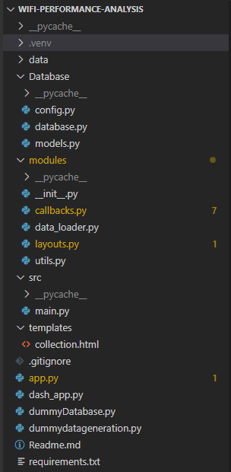
File Tree

Slide 10
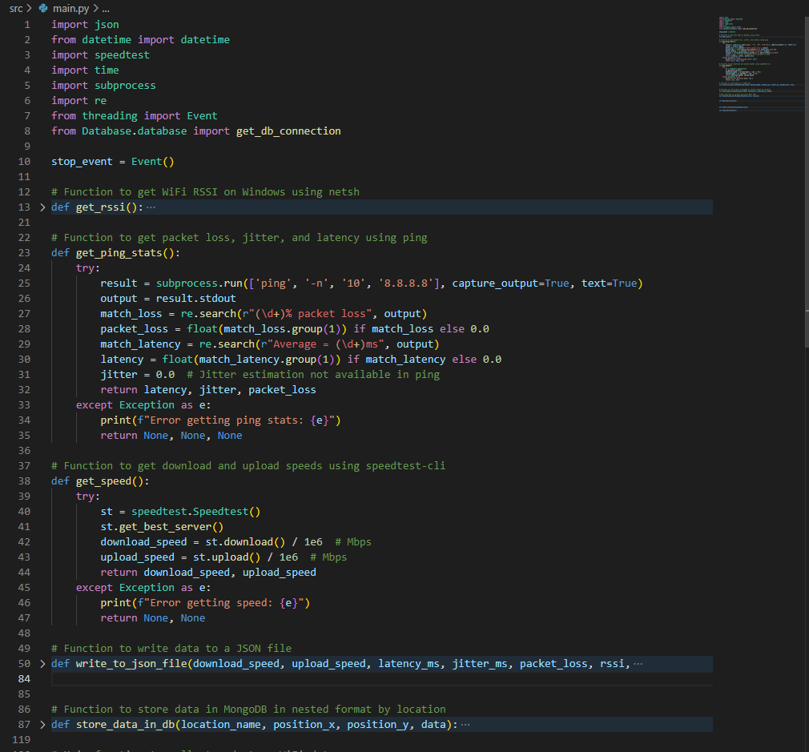
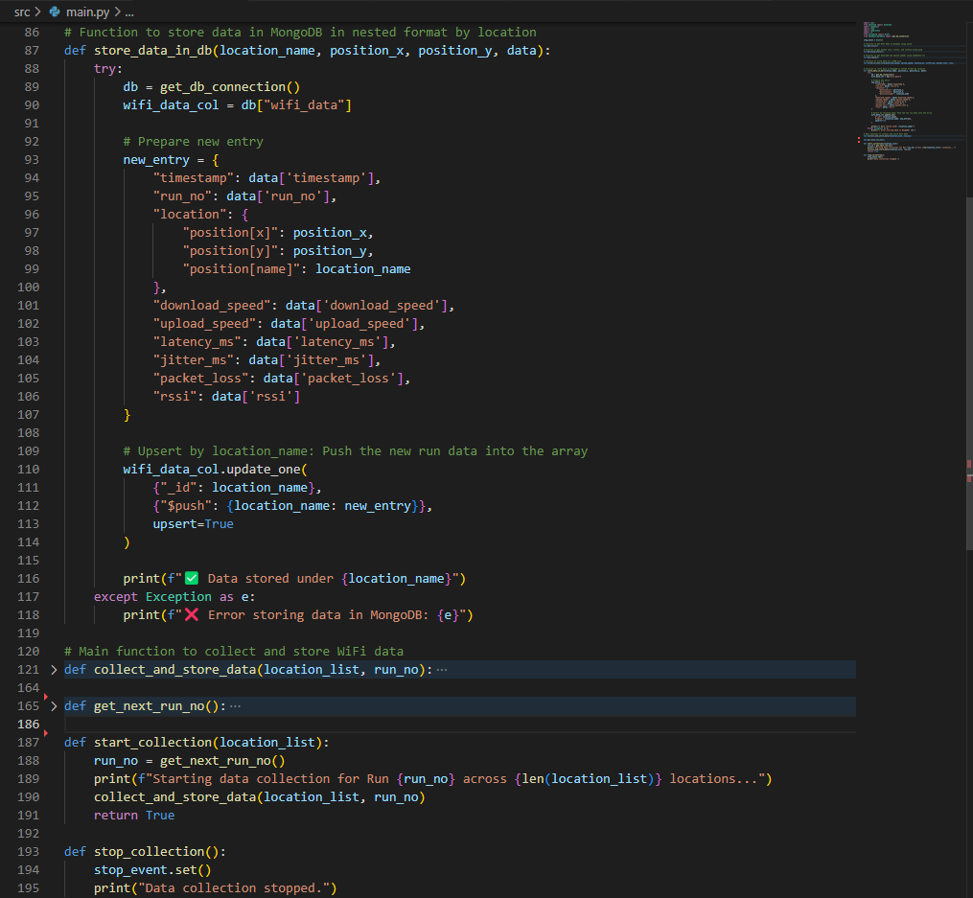
Code Snippet : Data Collection & Store

Slide 11
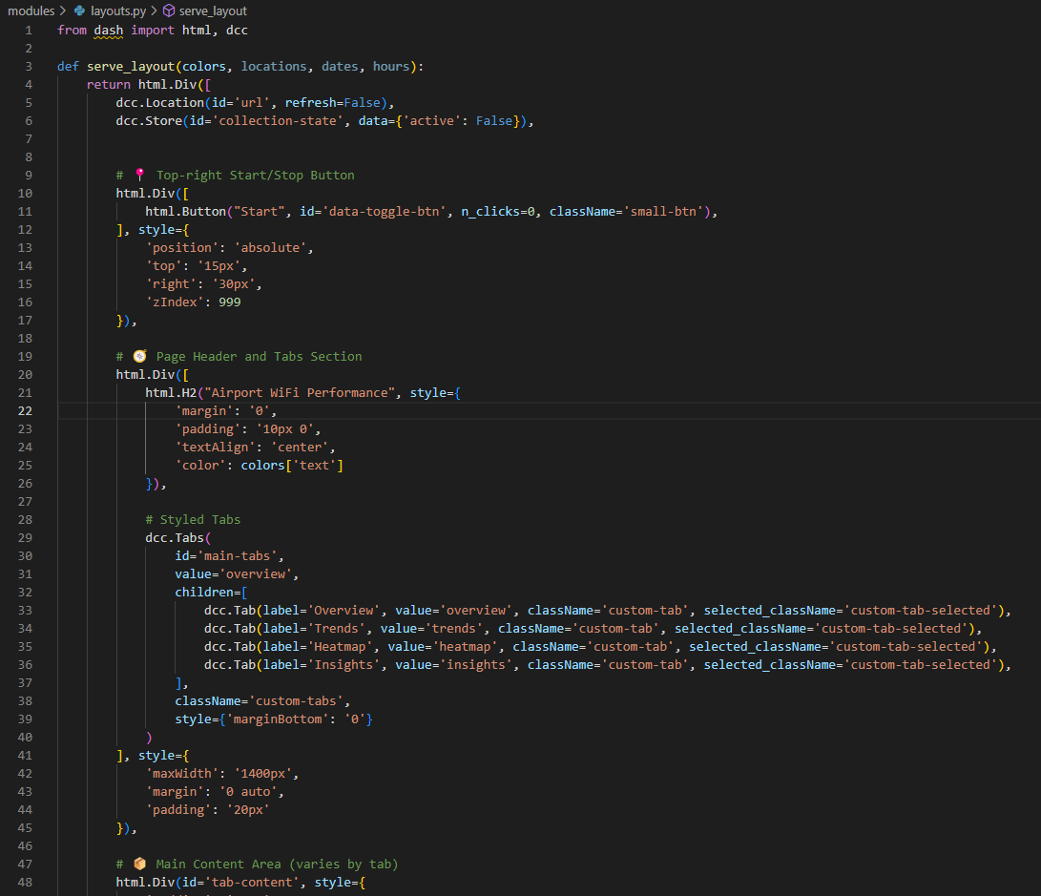
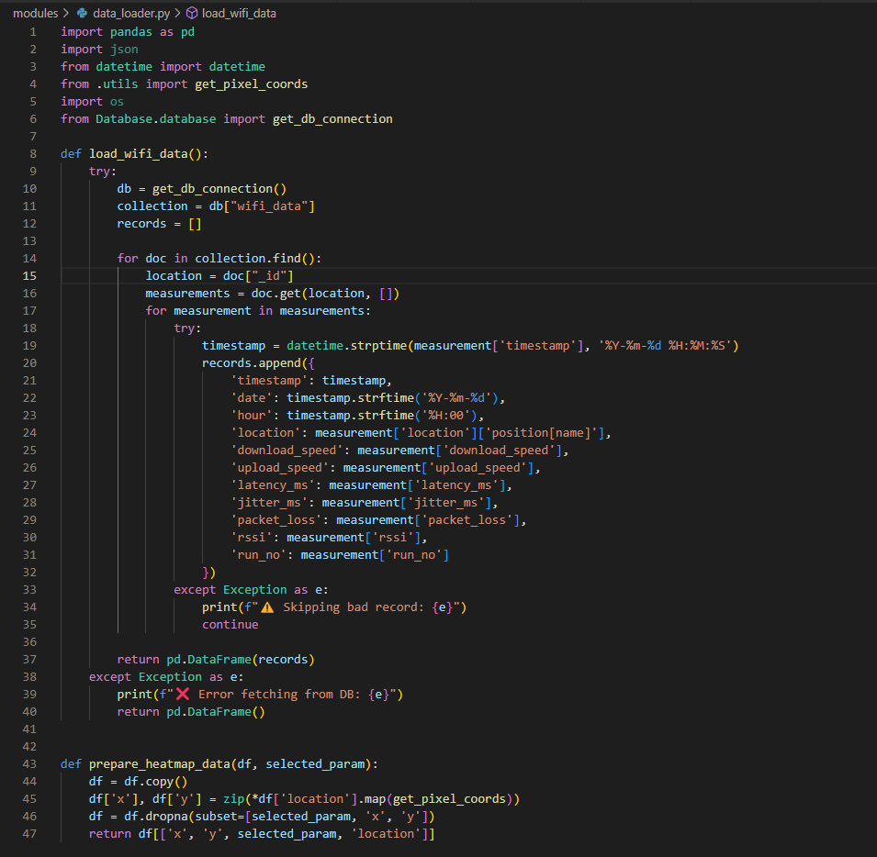
Code Snippet : Analyse & Visualize – Layouts, Data Loader

Slide 12
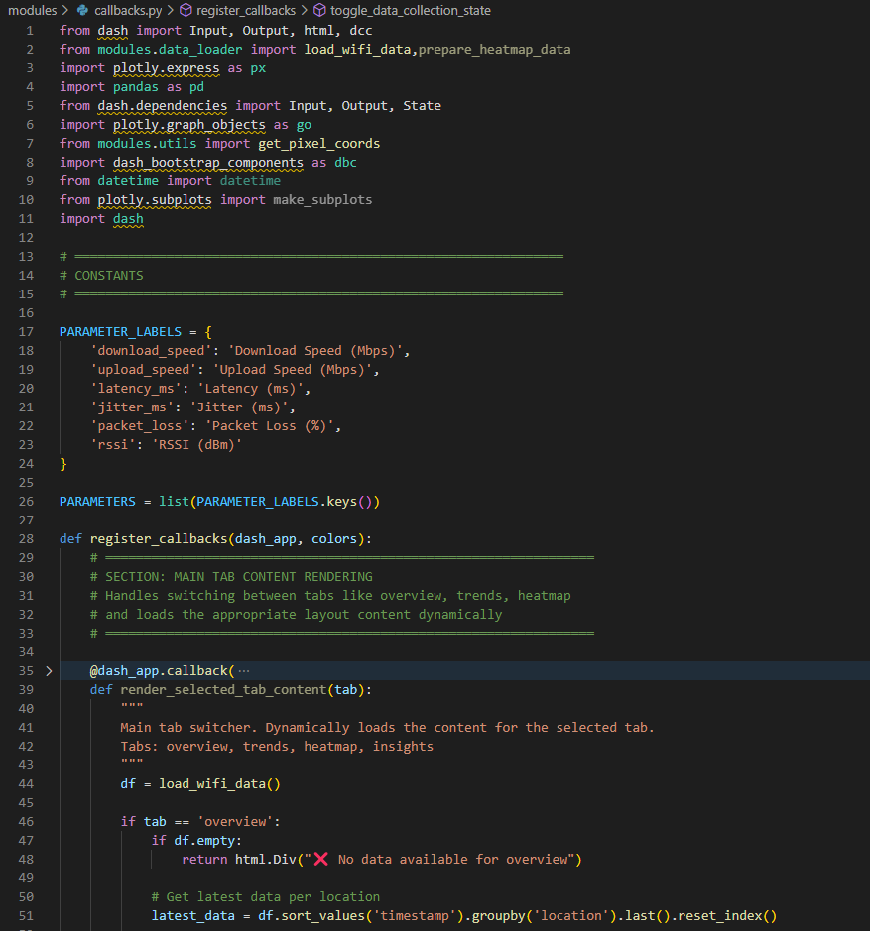
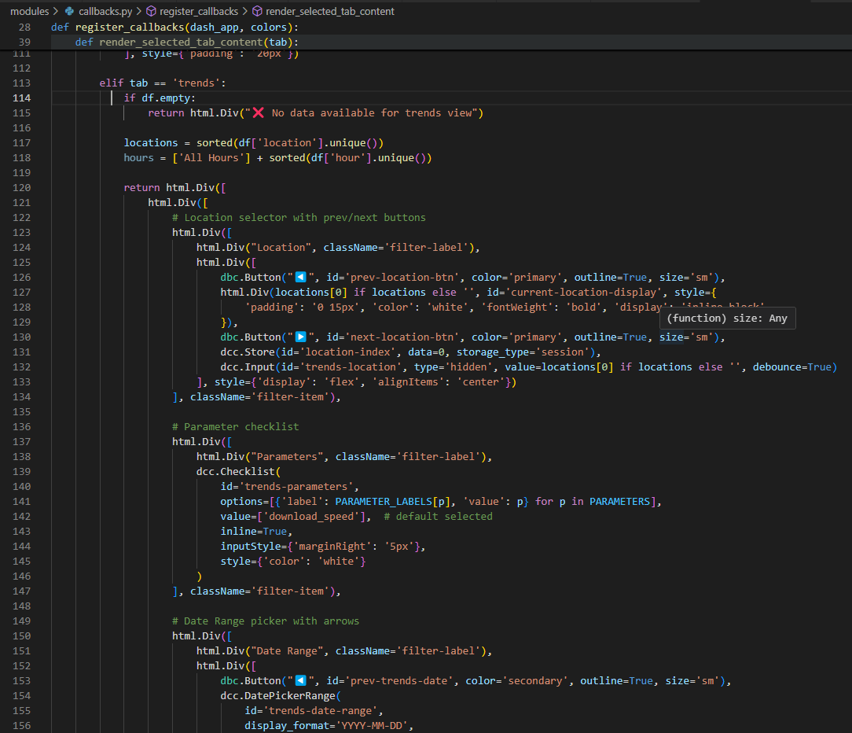
Code Snippet : Analyse & Visualize – Callbacks

Slide 13
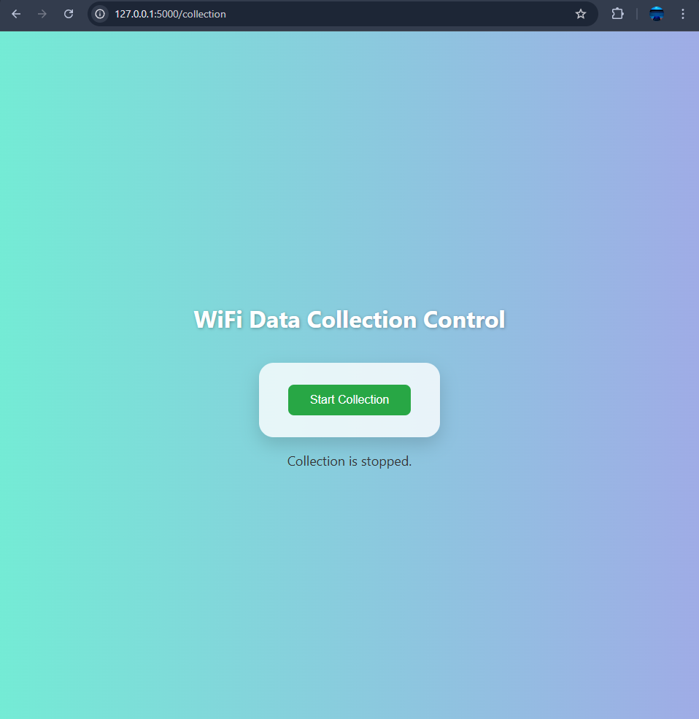
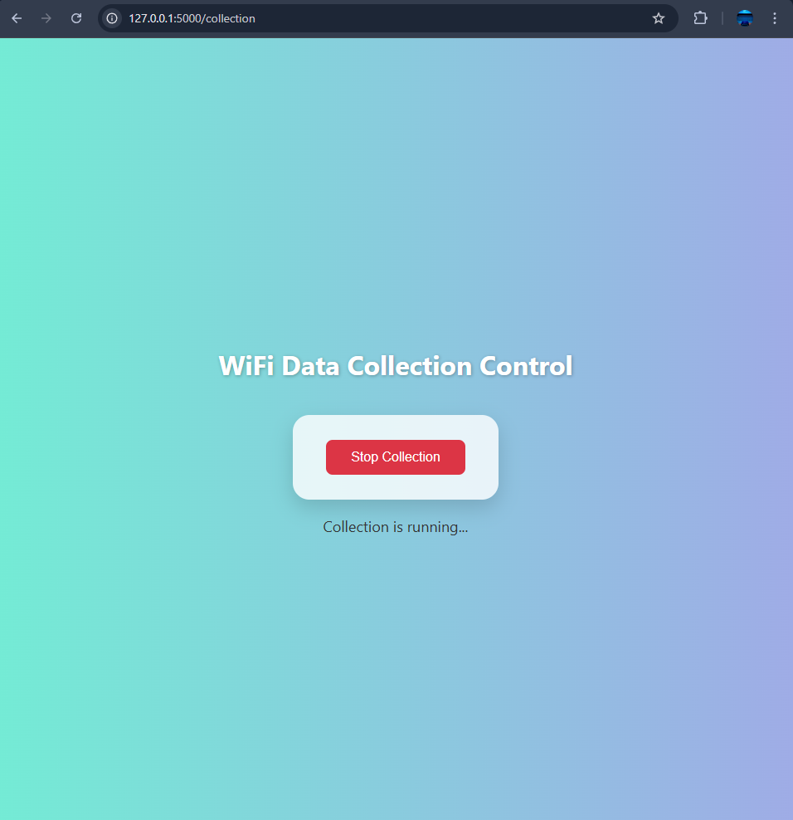
Data Collection - UI

Slide 14
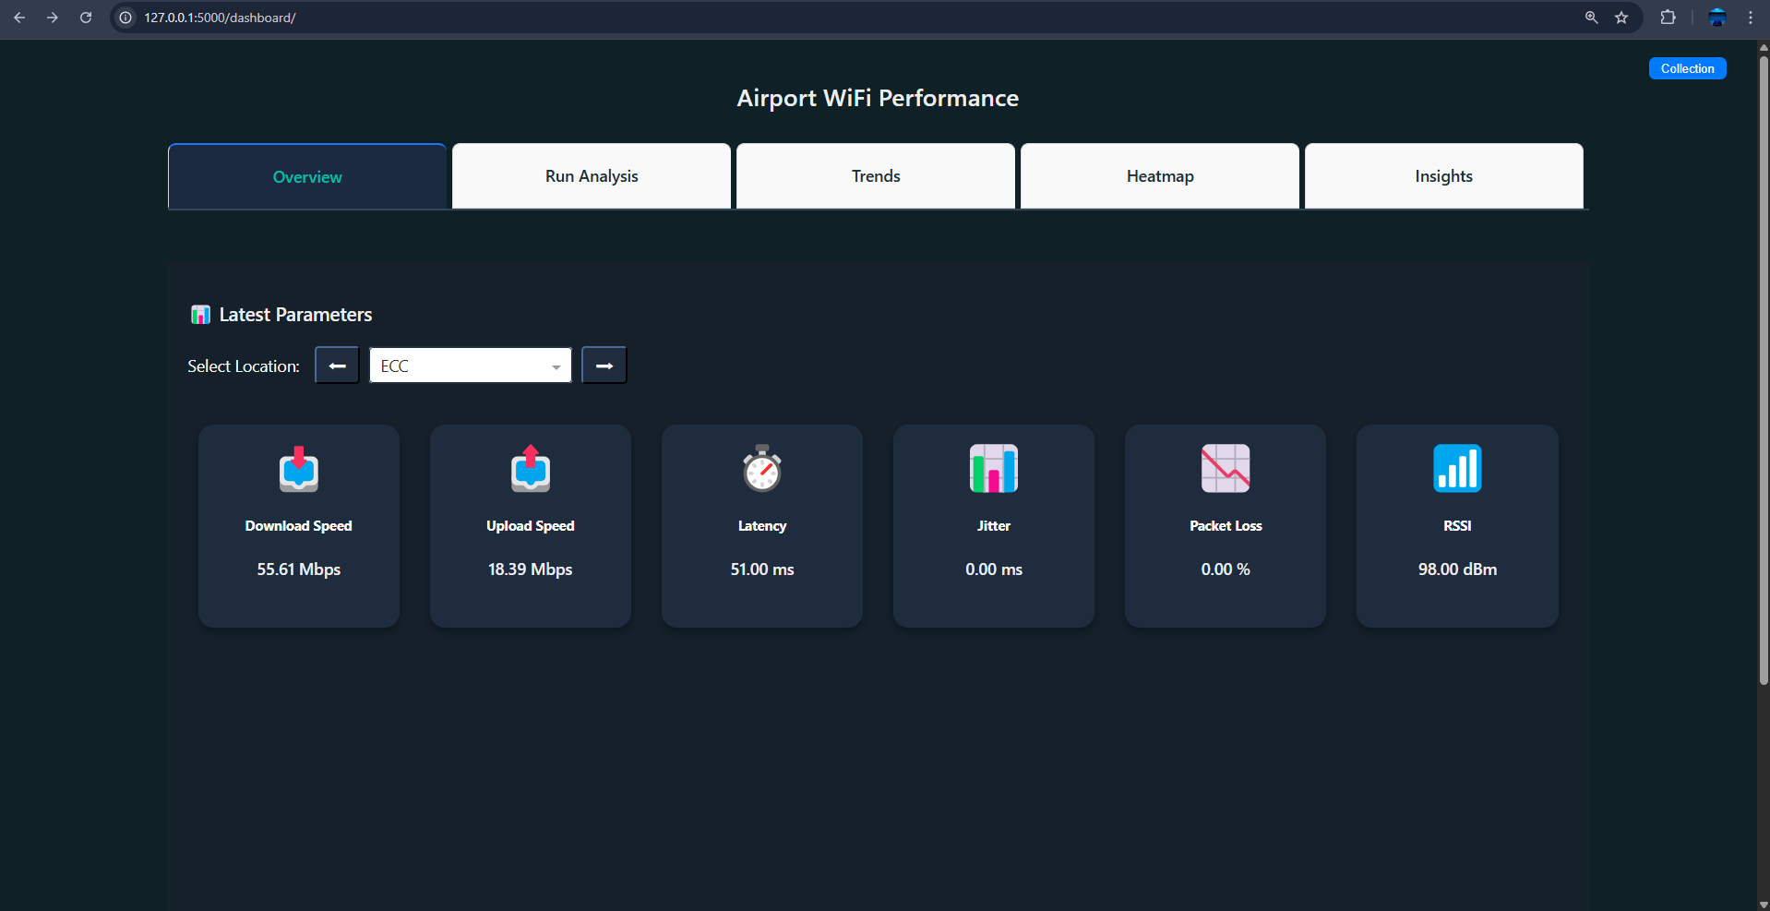
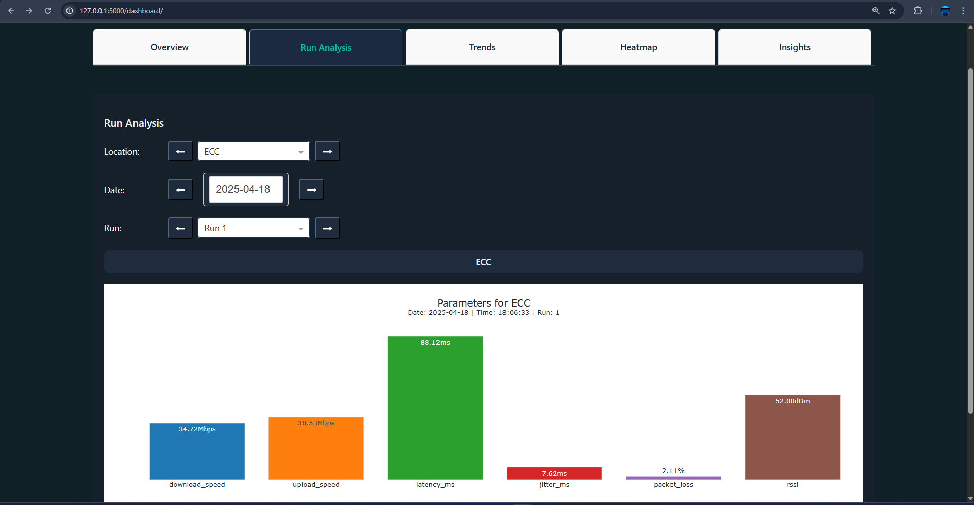
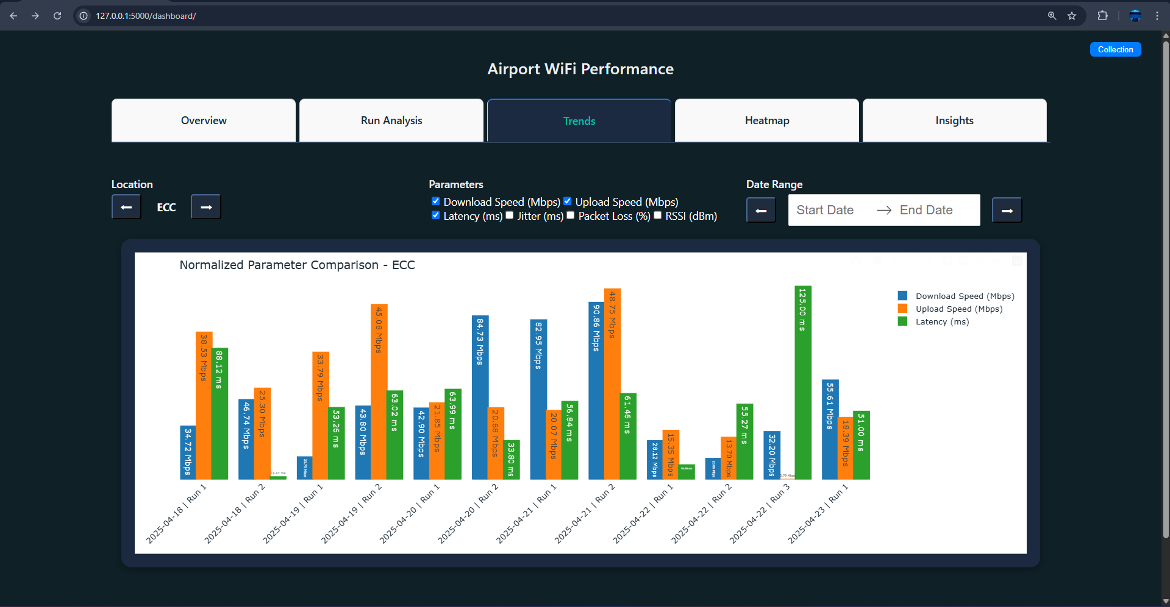
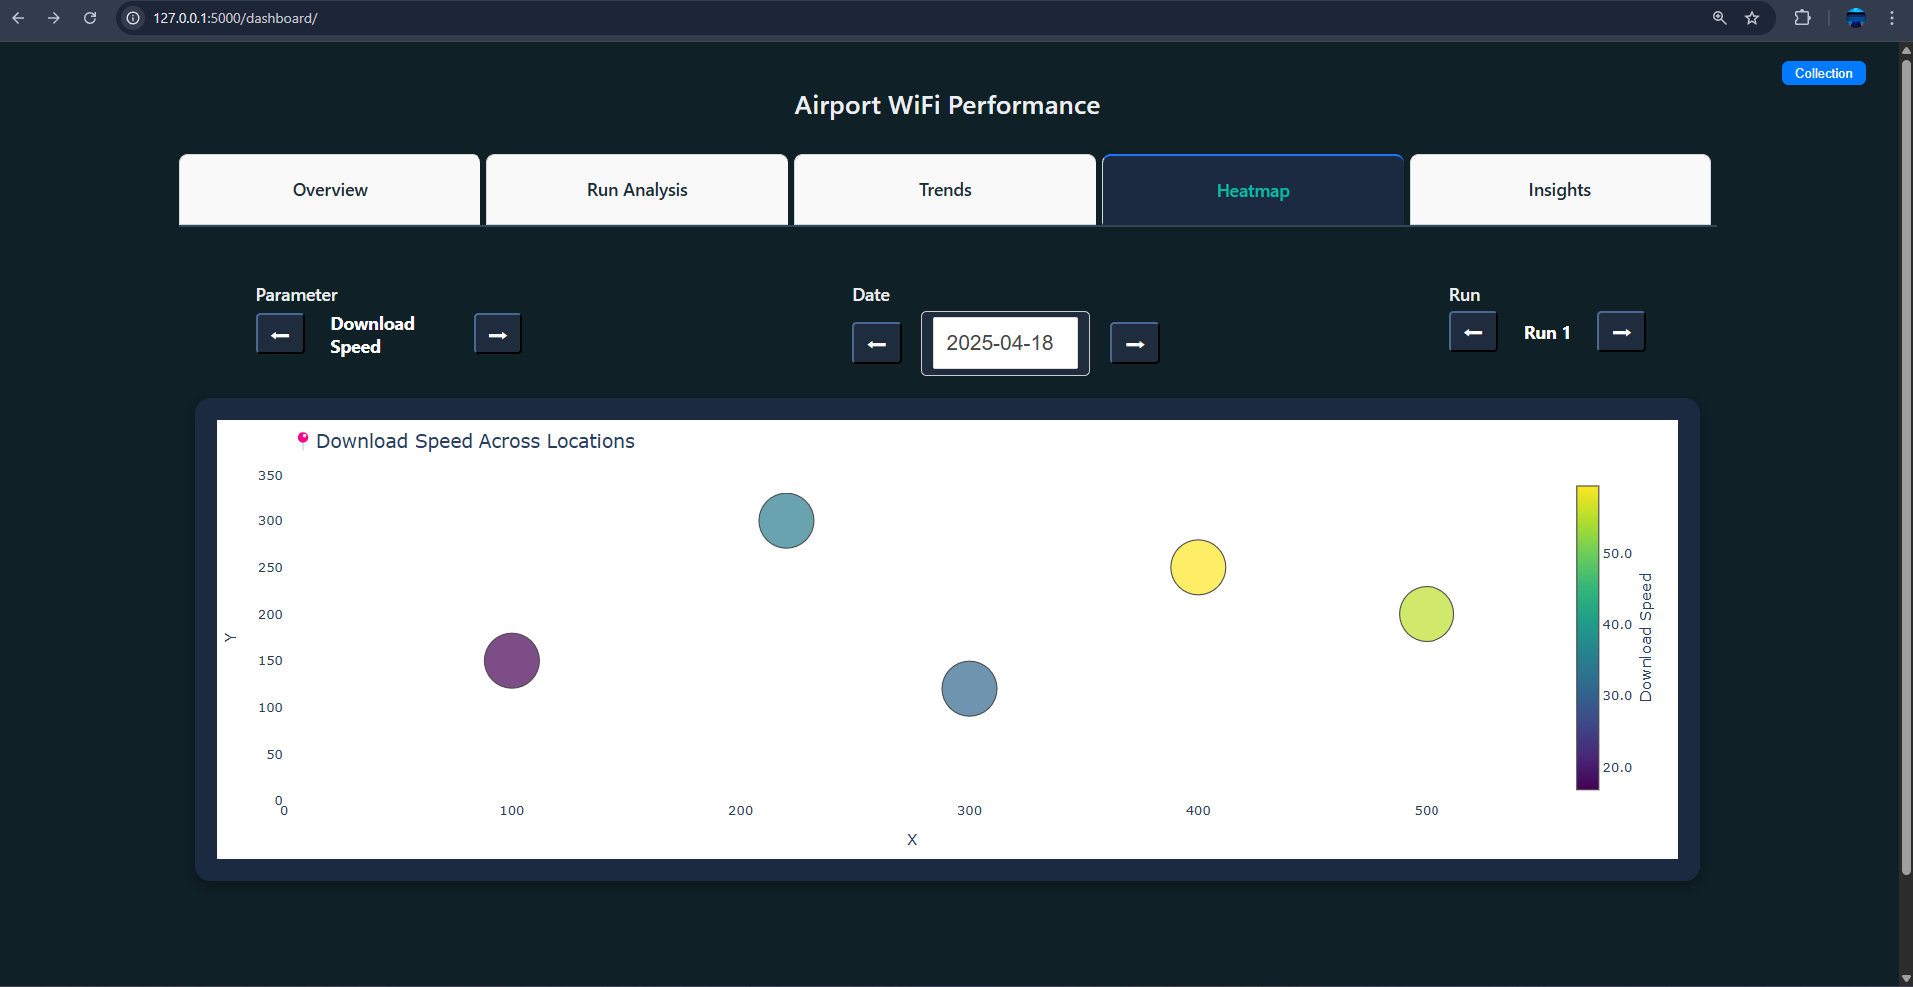
Data Visualization & Analyse - Dashboard UI

Slide 15
Challenges Faced and Solutions & Workarounds
Challenges Faced | Solutions & Workarounds
Zero or missing values (e.g., upload speed = 0) | Filtered out null/zero entries and labeled them clearly during visualization
Visualization of sparse or inconsistent data | Simulated multiple test runs to generate more consistent and analyzable data
Grouped charts with mixed-scale parameters | Applied normalized values, and added clear legends for better readability
Choosing appropriate visualization types | Experimented with various chart styles → finalized on bar graphs and heatmaps
UI inefficiency during early stages | Refined layout for better toggle controls, and responsiveness
Difficulty in consistent scan execution | Used threading for smooth, periodic data collection without overlap

Slide 16
Conclusions
✅ Successfully implemented an automated monitoring system
✅ Enabled real-time data collection with efficient storage solutions
✅ Provided clear insights through visual trend analysis and reporting
✅ Designed with scalability, modularity, and efficiency for easy deployment in various environments

Slide 17
Possible Improvements
Add More Parameters
Include Browsing performance, video streaming performance for deeper analysis
2. Real-Time Dashboard
Live monitoring of ongoing tests
Auto-refresh charts with latest performance metrics
3. Smart Alerts & Notifications
Trigger alerts for threshold breaches (e.g., high latency, no signal)
Notify admins for quick diagnostics and response
4. Cross-Platform Compatibility
Develop lightweight mobile version for field engineers
Sync data with centralized backend
5. Automated Optimization Suggestions
Recommend better access points or time slots based on patterns
Use historical trends to improve user experience

Slide 18
Thank you

